Slide 1
Numerical methods and optimization
TUTO2 Toolbox
Nolinear equations of type f(x)=0 resolution methods

Slide 2
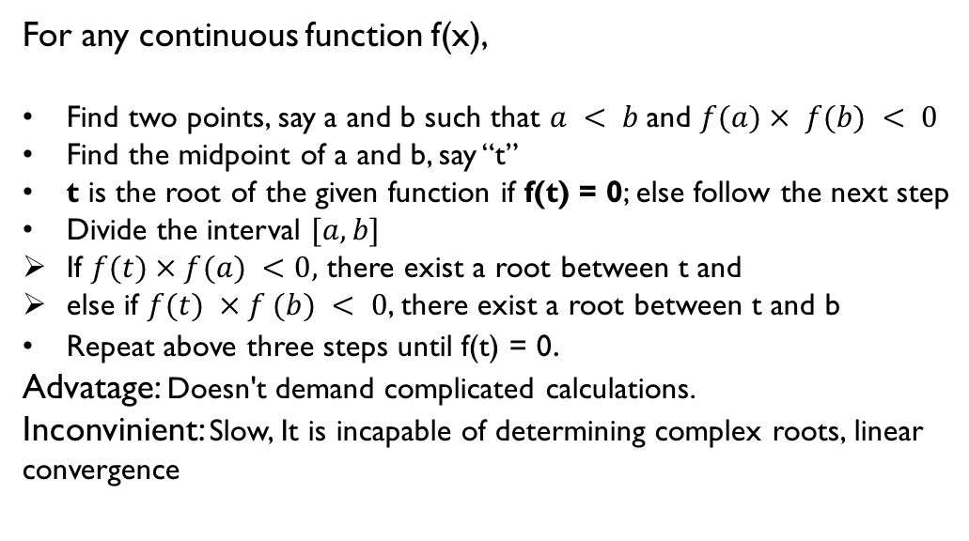
Bissection Method
For any continuous function f(x),
Find two points, say a and b such that $a < b$and $f(a)× f(b) < 0$
Find the midpoint of a and b, say “t”
t is the root of the given function if f(t) = 0; else follow the next step
Divide the interval $[a, b]$
If $f(t)×f(a) <0,$ there exist a root between t and
else if $f(t) ×f (b) < 0$, there exist a root between t and b
Repeat above three steps until f(t) = 0.
Advatage: Doesn't demand complicated calculations.
Inconvinient: Slow, It is incapable of determining complex roots, linear convergence

Slide 3
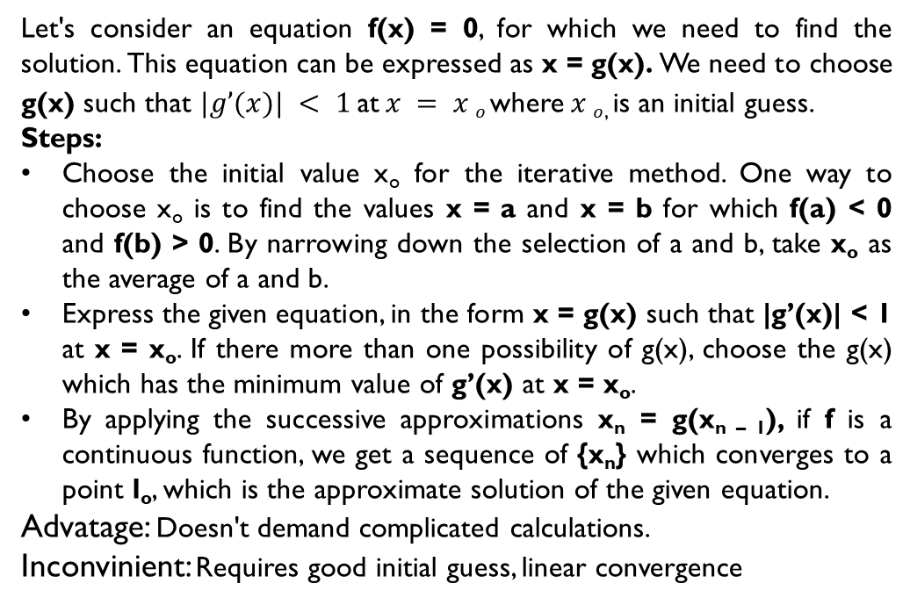
Fixed point Method
Let's consider an equation f(x) = 0, for which we need to find the solution. This equation can be expressed as x = g(x). We need to choose g(x) such that $|g’(x)| < 1$at$x = x o$where$x o$, is an initial guess.
Steps:
Choose the initial value x_{o} for the iterative method. One way to choose x_{o} is to find the values x = a and x = b for which f(a) < 0 and f(b) > 0. By narrowing down the selection of a and b, take x_{o} as the average of a and b.
Express the given equation, in the form x = g(x) such that |g’(x)| < 1 at x = x_{o}. If there more than one possibility of g(x), choose the g(x) which has the minimum value of g’(x) at x = x_{o}.
By applying the successive approximations x_{n} = g(x_{n – 1}), if f is a continuous function, we get a sequence of {x_{n}} which converges to a point l_{o}, which is the approximate solution of the given equation.
Advatage: Doesn't demand complicated calculations.
Inconvinient: Requires good initial guess, linear convergence

Slide 4
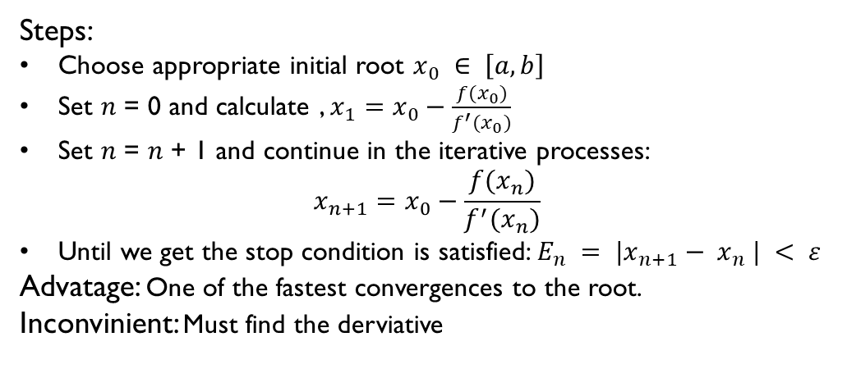
NewtoN-raphson Method
Steps:
Choose appropriate initial root $x_{0} ∈ \left[a, b\right]$
Set 𝑛 = 0 and calculate , $x_{1}=x_{0}−\frac{{f(x}_{0})}{f^{′}(x_{0})}$
Set 𝑛 = 𝑛 + 1 and continue in the iterative processes:
$$x_{n+1}=x_{0}−\frac{{f(x}_{n})}{f^{′}(x_{n})}$$
Until we get the stop condition is satisfied: $E_{n} = |x_{n+1}− x_{n} | < ε$
Advatage: One of the fastest convergences to the root.
Inconvinient: Must find the derviative

Slide 5
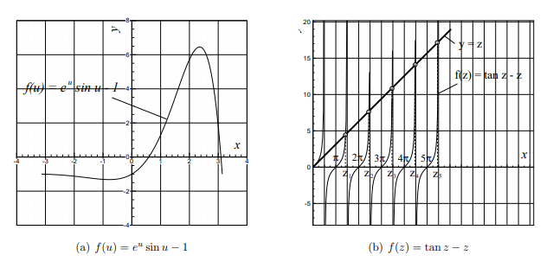
Exercise 1 graphs

Slide 6
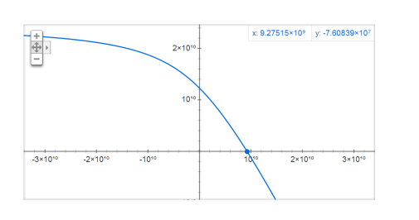
Exercise 2 graph

Slide 7
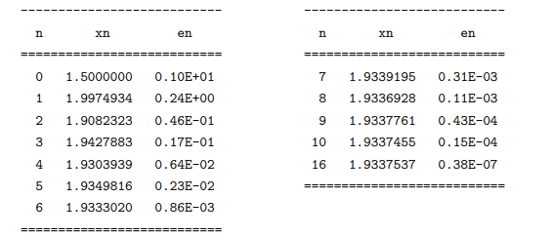
Exercise 3 Iterations

